Slide 1
Procurement Dashboards (2)
File created on: 05-Jul-23 1:33:28 PM

Slide 2
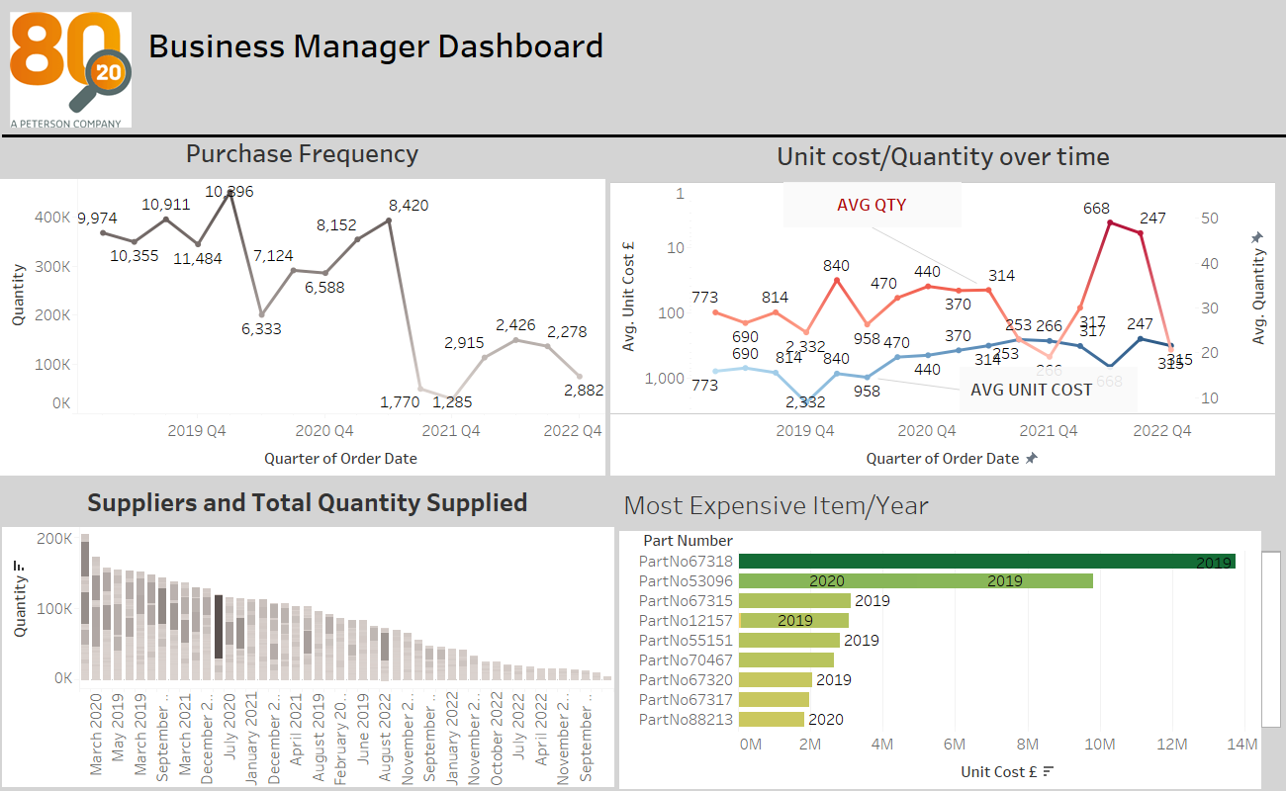

Slide 3
